Slide 1
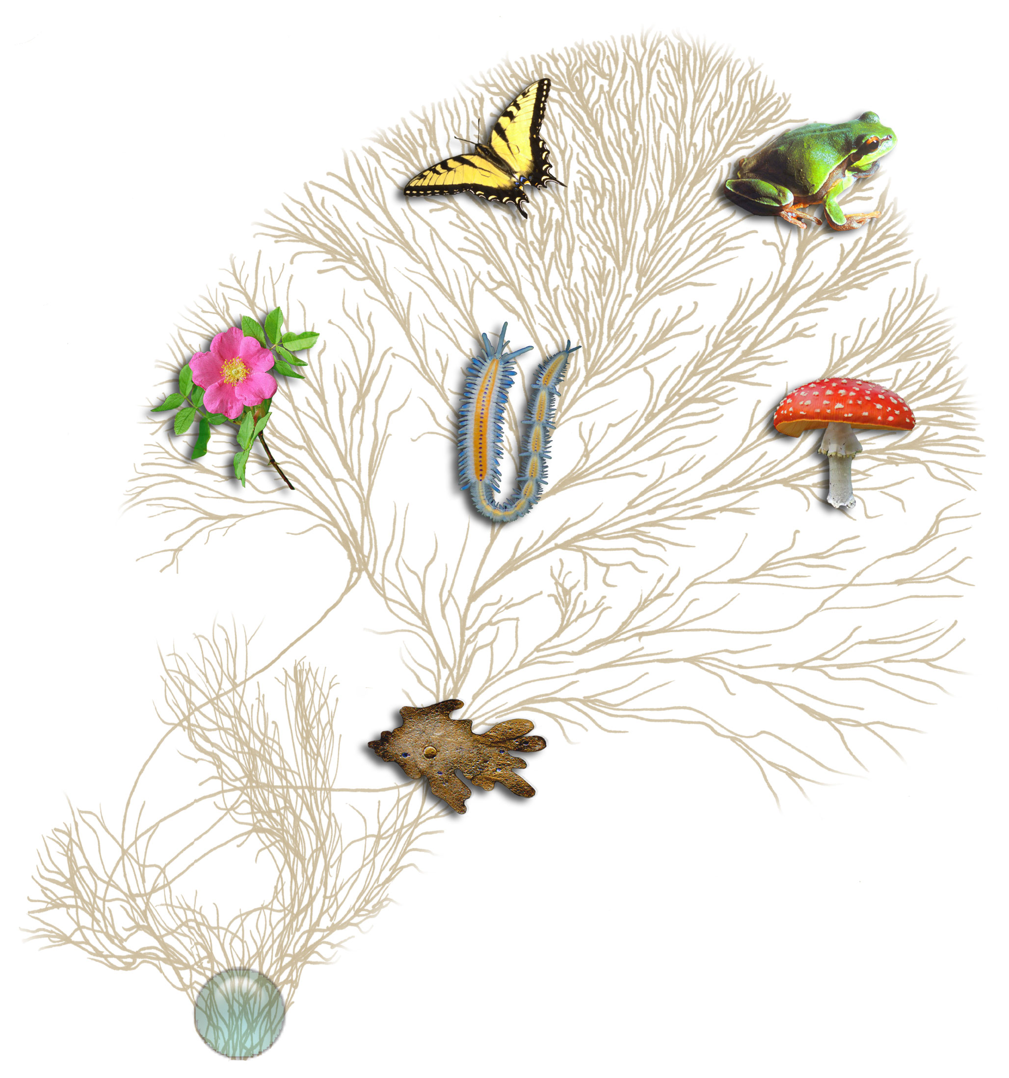
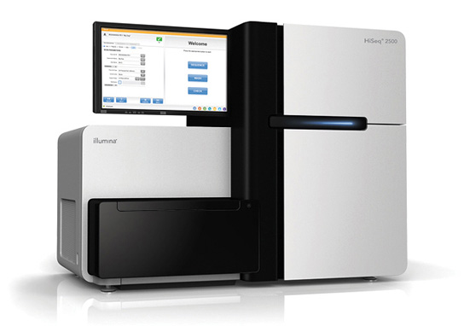
RNA-Seq Empowers Transcriptome Studies
Extract RNA, convert to cDNA
Next-gen Sequencer
(pick your favorite)
Notes:
RNA-Seq is a powerful technology for identifying genes and profiling gene expression in any living organism.
----
It just requires that you can collect RNA molecules from your sample of interest, convert it to cDNA,
---
and then perform high throughput sequencing using your favorite next-generation sequencing technology.
# image from: http://tolweb.org/tree/home.pages/aboutoverview.html#imguse

Slide 2
RNA-Seq Empowers Many Facets of Biological Investigations
Transcript identification (ie. which genes active)
Expression Levels
Alternative splicing isoforms
Allelic variants
Mutations
Fusion Transcripts
RNA-editing

Slide 3
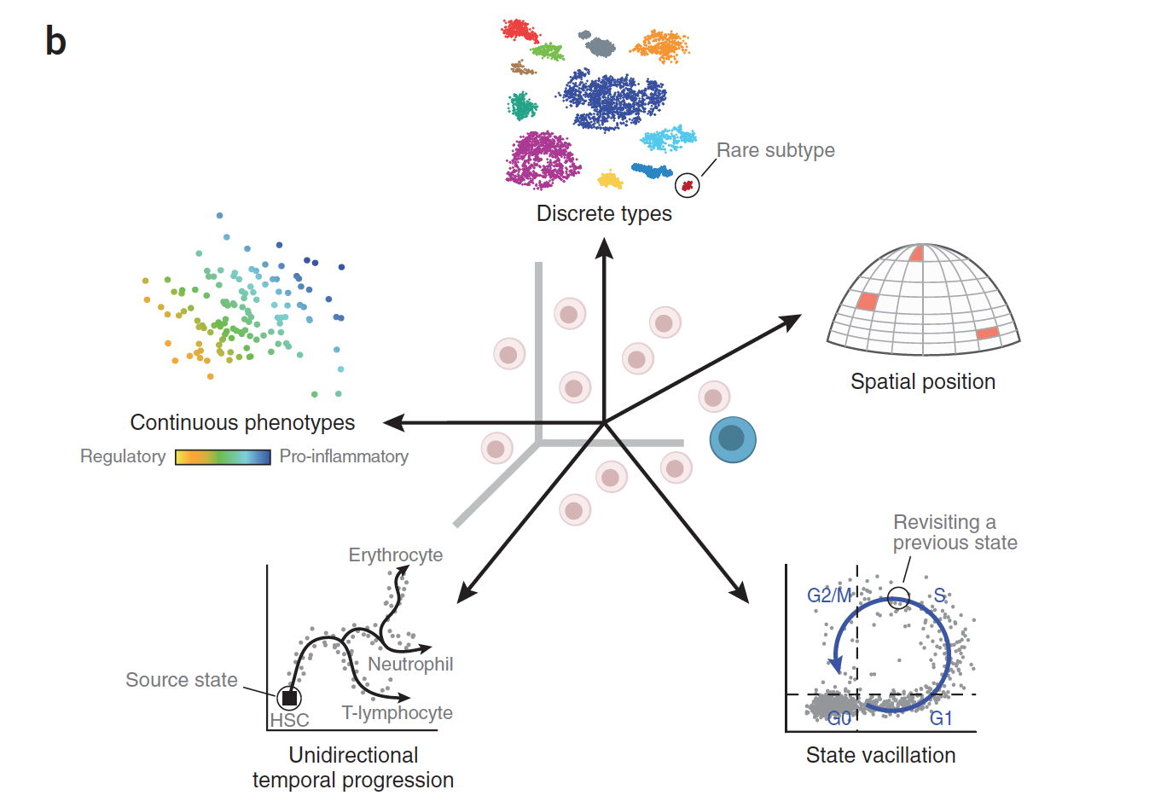
RNA-Seq is Empowering Discovery at Single Cell Resolution
Wagner, Regev, and Yosef. NBT 2016

Slide 4
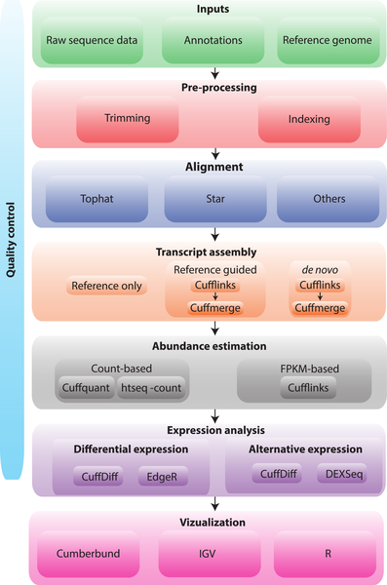

RNA-seq analysis flow chart.
http://journals.plos.org/ploscompbiol/article?id=10.1371/journal.pcbi.1004393

Slide 5
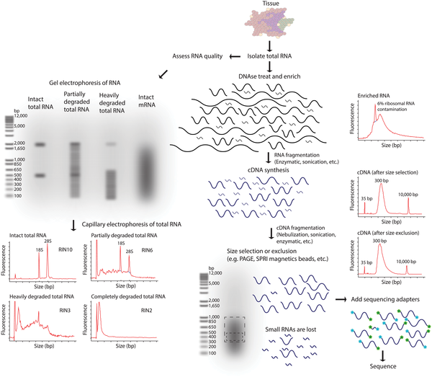
RNA-seq library fragmentation and size selection strategies that influence interpretation and analysis.
http://journals.plos.org/ploscompbiol/article?id=10.1371/journal.pcbi.1004393

Slide 6
RNA-seq library fragmentation and size selection strategies that influence interpretation and analysis.
http://journals.plos.org/ploscompbiol/article?id=10.1371/journal.pcbi.1004393

Slide 7
RNA-seq library fragmentation and size selection strategies that influence interpretation and analysis.
http://journals.plos.org/ploscompbiol/article?id=10.1371/journal.pcbi.1004393

Slide 8
RNA-seq library fragmentation and size selection strategies that influence interpretation and analysis.
http://journals.plos.org/ploscompbiol/article?id=10.1371/journal.pcbi.1004393

Slide 9
RNA-seq library fragmentation and size selection strategies that influence interpretation and analysis.
http://journals.plos.org/ploscompbiol/article?id=10.1371/journal.pcbi.1004393

Slide 10
RNA-Seq: How do we make cDNA?
Prime with Random Hexamers (R6)
mRNA
5’
3’
R₆
R₆
R₆
Reverse transcriptase
cDNA First strand synthesis
R₆
R₆
R₆
RNase H
DNA polymerase
DNA Ligase
cDNA Second strand synthesis
Illumina cDNA Library
Slide courtesy of Joshua Levin, Broad Institute.

Slide 11
RNA-seq library fragmentation and size selection strategies that influence interpretation and analysis.
http://journals.plos.org/ploscompbiol/article?id=10.1371/journal.pcbi.1004393

Slide 12
RNA-seq library fragmentation and size selection strategies that influence interpretation and analysis.
http://journals.plos.org/ploscompbiol/article?id=10.1371/journal.pcbi.1004393

Slide 13
RNA-seq library fragmentation and size selection strategies that influence interpretation and analysis.
http://journals.plos.org/ploscompbiol/article?id=10.1371/journal.pcbi.1004393

Slide 14
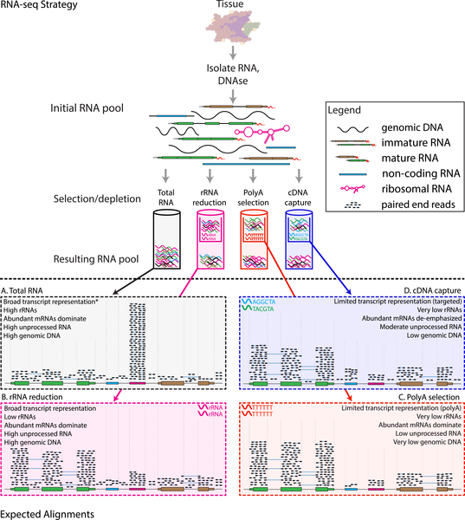
RNA-seq library enrichment strategies that influence interpretation and analysis.
http://journals.plos.org/ploscompbiol/article?id=10.1371/journal.pcbi.1004393

Slide 15
RNA-seq library enrichment strategies that influence interpretation and analysis.
http://journals.plos.org/ploscompbiol/article?id=10.1371/journal.pcbi.1004393

Slide 16
RNA-seq library enrichment strategies that influence interpretation and analysis.
http://journals.plos.org/ploscompbiol/article?id=10.1371/journal.pcbi.1004393

Slide 17
RNA-seq library enrichment strategies that influence interpretation and analysis.
http://journals.plos.org/ploscompbiol/article?id=10.1371/journal.pcbi.1004393

Slide 18
RNA-seq library enrichment strategies that influence interpretation and analysis.
http://journals.plos.org/ploscompbiol/article?id=10.1371/journal.pcbi.1004393

Slide 19
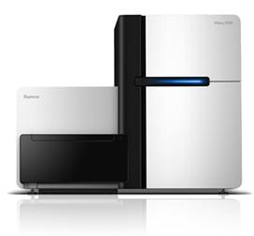
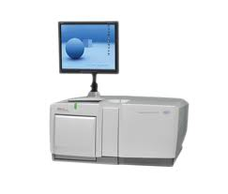
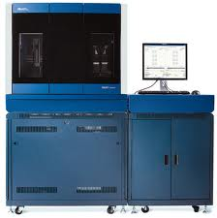
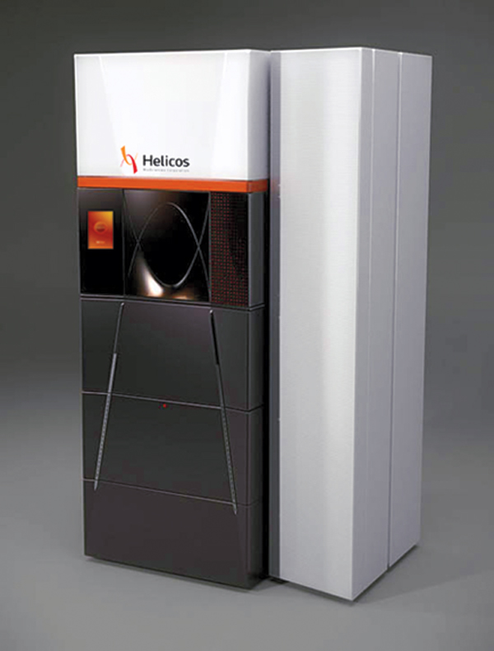
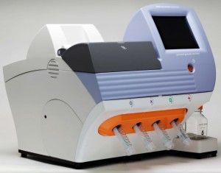
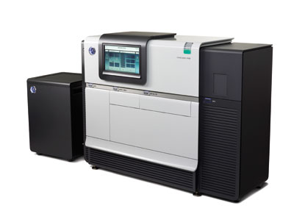
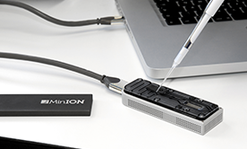
Generating RNA-Seq: How to Choose?
Many different instruments hit the scene in the last decade
Illumina
454
SOLiD
Helicos
Ion Torrent
Pacific Biosciences
Oxford Nanopore
Slide courtesy of Joshua Levin, Broad Institute.

Slide 20
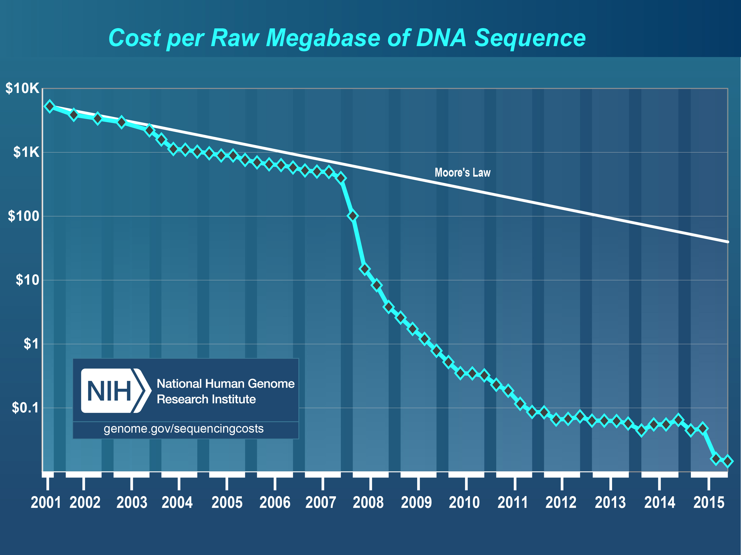
Hello Next-Gen Sequencing!
From https://www.genome.gov/sequencingcostsdata/

Slide 21
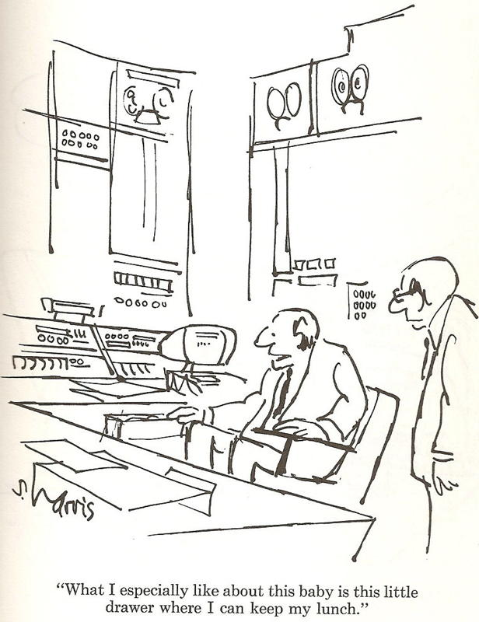
Generating RNA-Seq: How to Choose?
Illumina
454
SOLiD
Helicos
Ion Torrent
Pacific Biosciences
Oxford Nanopore
Slide courtesy of Joshua Levin, Broad Institute.

Slide 22
Generating RNA-Seq: How to Choose?
Popular choices for RNA-Seq today
Illumina
454
SOLiD
Helicos
Ion Torrent
Pacific Biosciences
Oxford Nanopore

Slide 23
Generating RNA-Seq: How to Choose?
Popular choices for RNA-Seq today
[Current RNA-Seq workhorse]
[Newly emerging technology for full-length single molecule sequencing]
Illumina
454
SOLiD
Helicos
[Full-length single molecule sequencing]
Ion Torrent
Pacific Biosciences
Oxford Nanopore

Slide 24
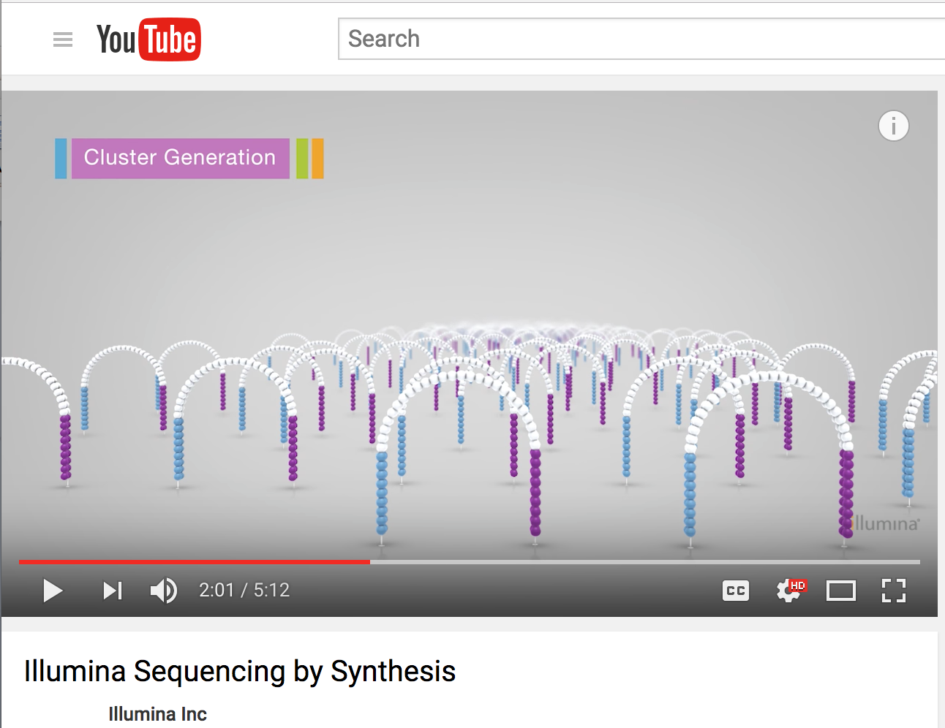
Illumina Sequencing by Synthesis
https://www.youtube.com/watch?v=fCd6B5HRaZ8

Slide 25
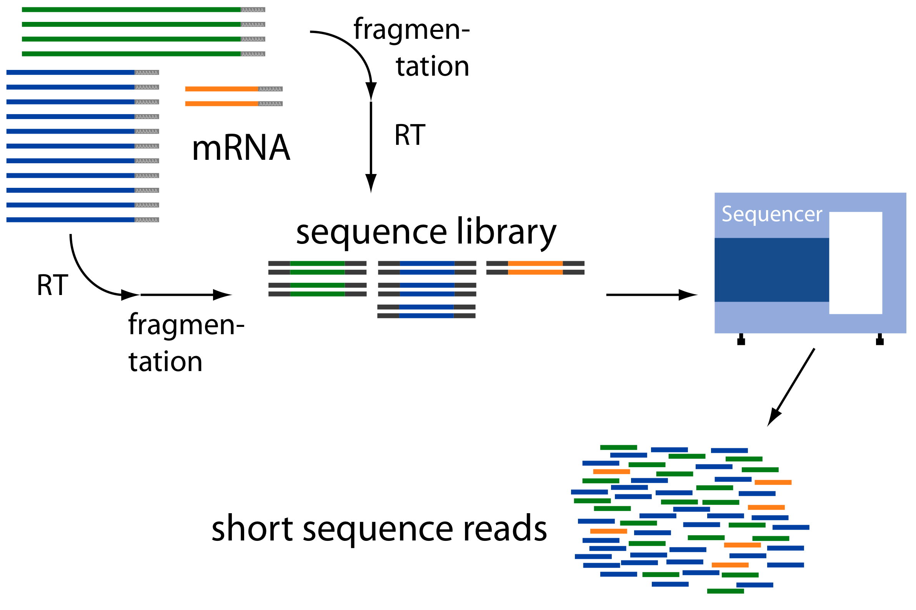
Millions to Billions of Reads
(Avg. ~ 2 kb)
(Avg. ~ 300 b)
(~ 75 to 150 b reads, SE or PE)
Adapted from: http://www2.fml.tuebingen.mpg.de/raetsch/members/research/transcriptomics.html
Notes:
These transcript fragments are then sequenced from one or both ends of the fragment, generating either single-end reads or paired-end reads, and the read lengths are typically on the order of 75 to 150 bases, although the technology is constantly improving and read lengths can be pushed into greater lengths.

Slide 26
Common Data Formats for RNA-Seq
FASTA format:
>61DFRAAXX100204:1:100:10494:3070/1
AAACAACAGGGCACATTGTCACTCTTGTATTTGAAAAACACTTTCCGGCCAT
FASTQ format:
@61DFRAAXX100204:1:100:10494:3070/1
AAACAACAGGGCACATTGTCACTCTTGTATTTGAAAAACACTTTCCGGCCAT
+
ACCCCCCCCCCCCCCCCCCCCCCCCCCCCCBC?CCCCCCCCC@@CACCCCCA
Read
Quality values

Slide 27
Interpreting Base Quality Values
@61DFRAAXX100204:1:100:10494:3070/1
AAACAACAGGGCACATTGTCACTCTTGTATTTGAAAAACACTTTCCGGCCAT
+
ACCCCCCCCCCCCCCCCCCCCCCCCCCCCCBC?CCCCCCCCC@@CACCCCCA
Read
Quality values
AsciiEncodedQual (‘B’) = 63
Phred_Quality_Value = AsciiEncodedQual(‘B’) – 33
= 30
Phred_Quality_Value = -10 * log₁₀(Pwrong(‘T’))
Pwrong(‘T’) = 10^(30/-10) = 10^-3 = 0.001

Slide 28
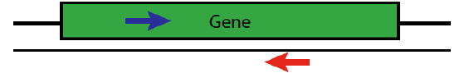
Paired-end Sequences
Two FastQ files, read name indicates left (/1) or right (/2) read of paired-end
@61DFRAAXX100204:1:100:10494:3070/1
AAACAACAGGGCACATTGTCACTCTTGTATTTGAAAAACACTTTCCGGCCAT
+
ACCCCCCCCCCCCCCCCCCCCCCCCCCCCCBC?CCCCCCCCC@@CACCCCCA
@61DFRAAXX100204:1:100:10494:3070/2
CTCAAATGGTTAATTCTCAGGCTGCAAATATTCGTTCAGGATGGAAGAACA
+
C<CCCCCCCACCCCCCCCCCCCCCCCCCCCCCCCCCCCCCCCCCCCCCBCCCC

Slide 29
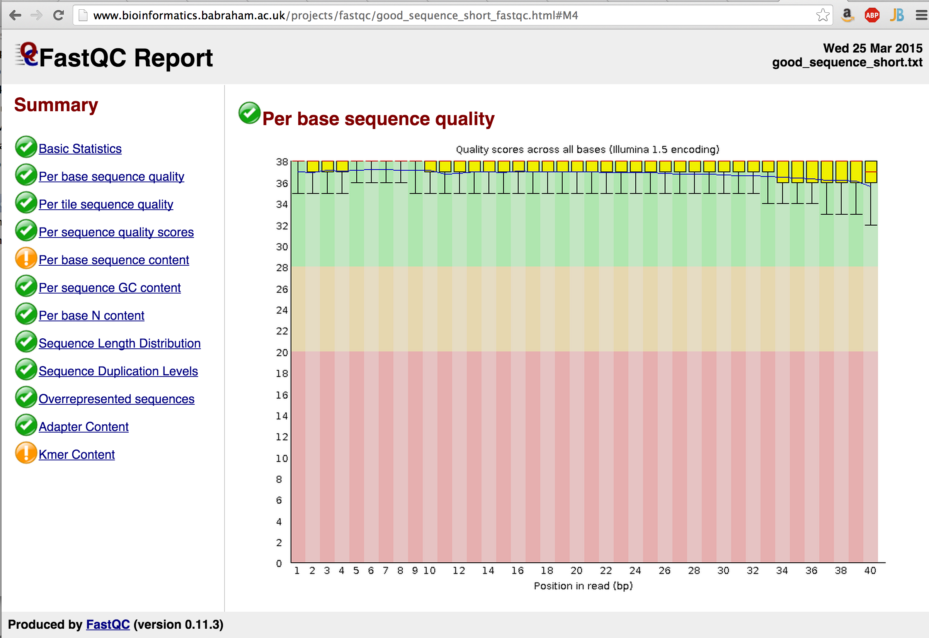

Slide 30
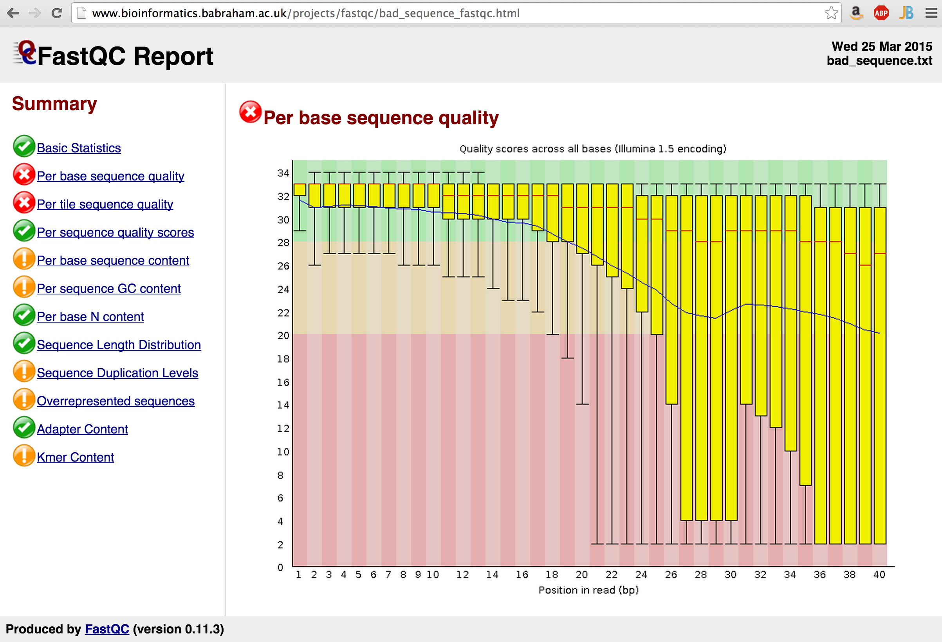

Slide 31
What to do?
Trim the reads?
Start over – try sequencing it again?

Slide 32
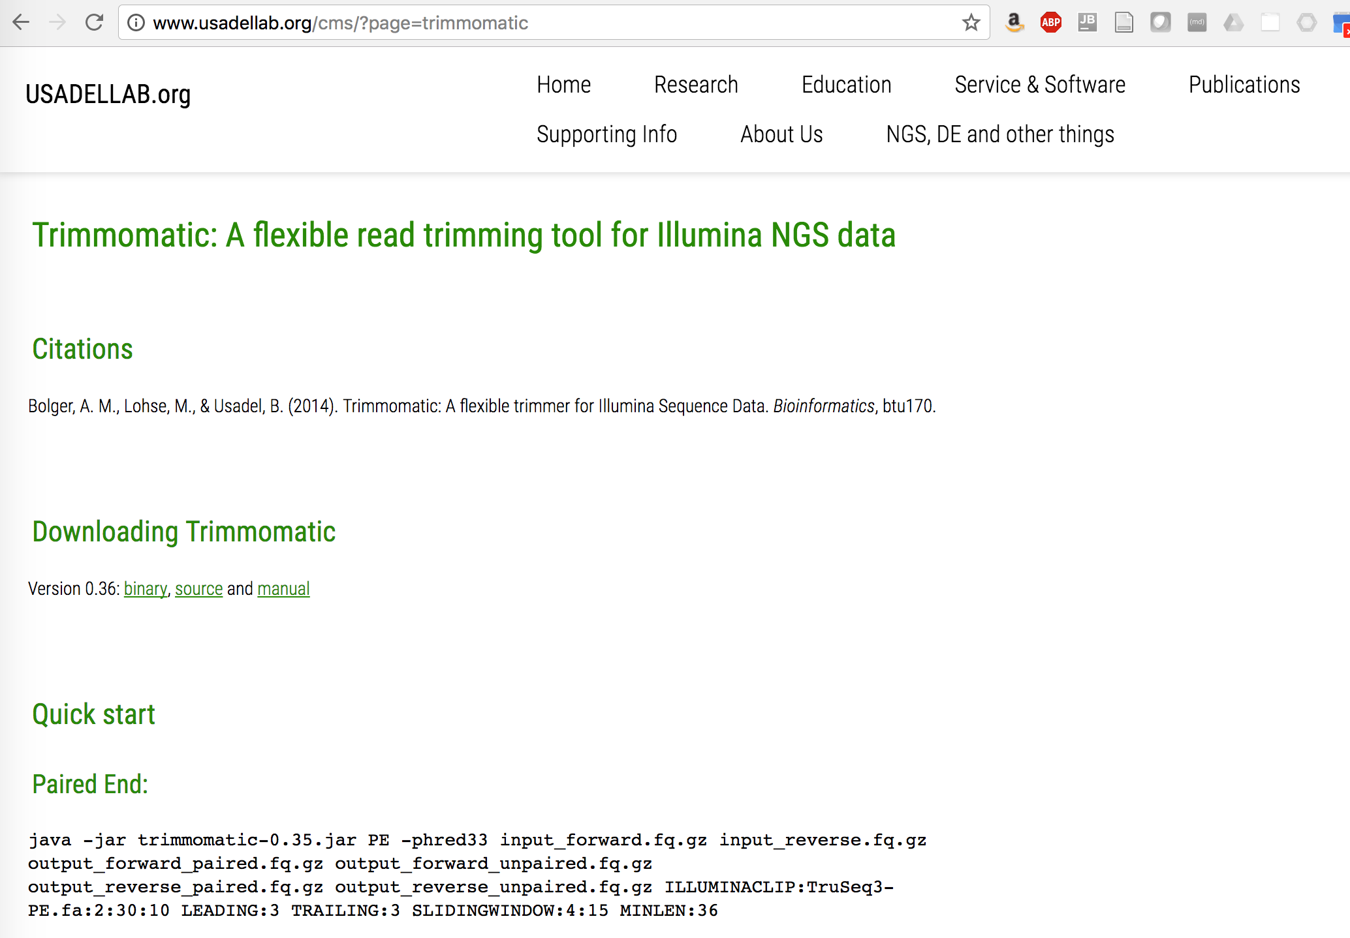
Trimming low quality regions of reads: Trimmomatic

Slide 33
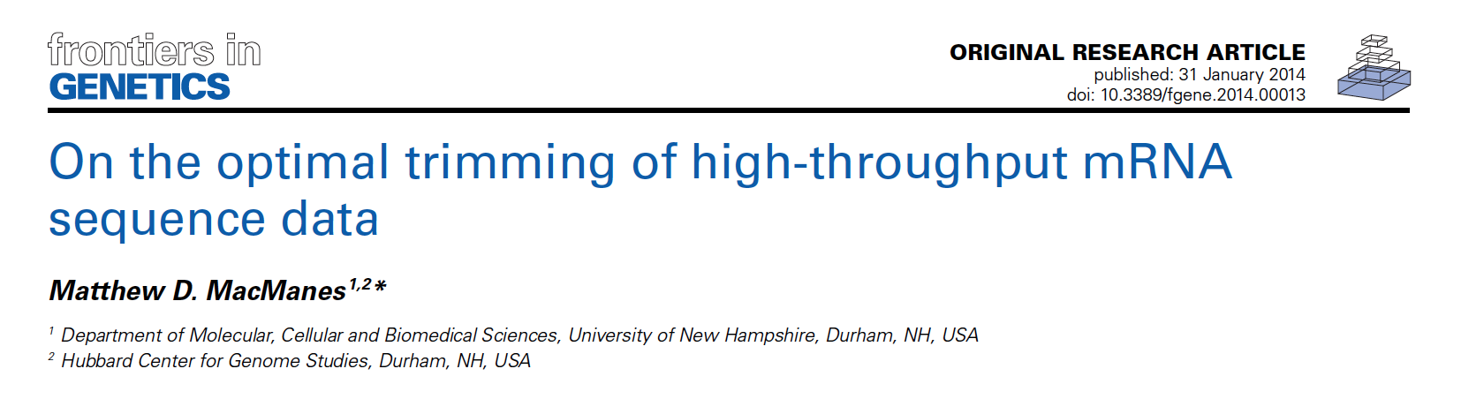
“… researchers interested in assembling transcriptomes de novo should elect for a much gentler quality trimming, or no trimming at all.”
“… trimming at PHRED=2 or PHRED=5 optimizes assembly quality.”

Slide 34
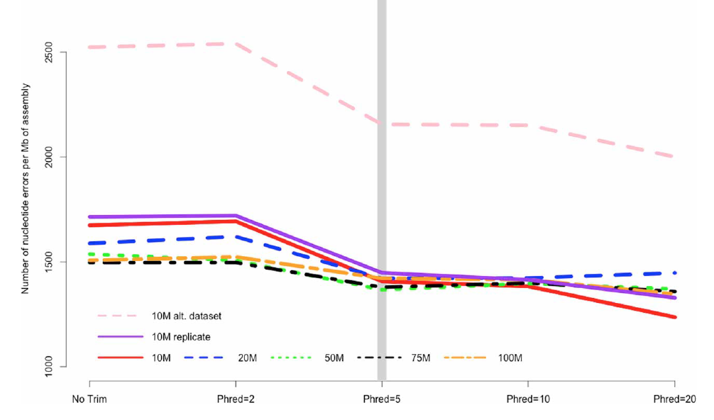
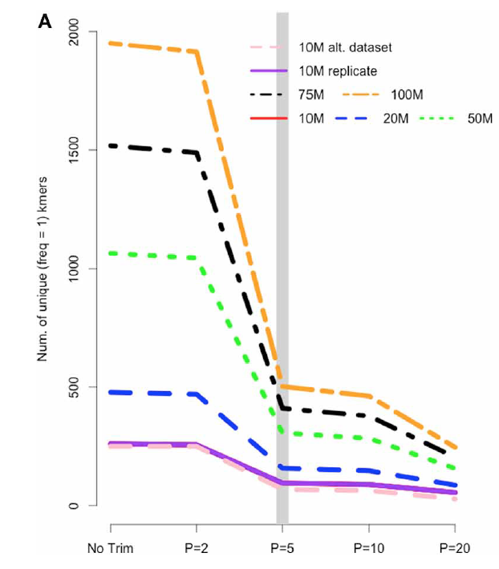
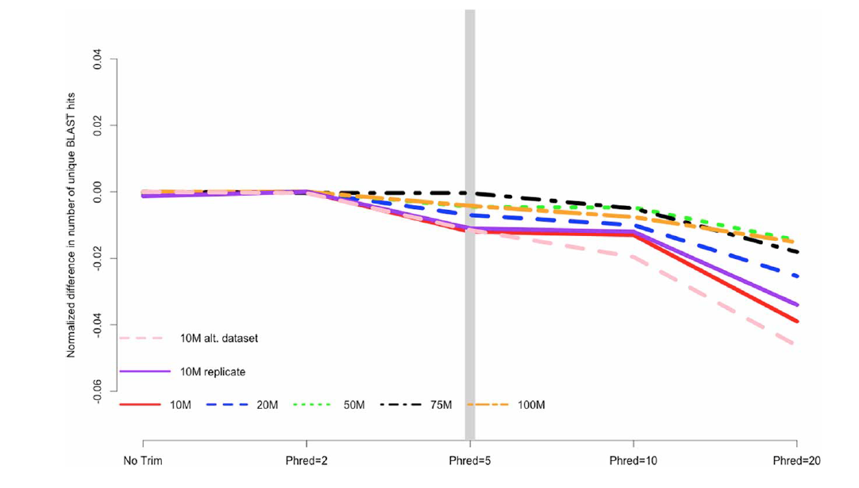
Aggressive Trimming may be harmful, whereas light trimming could be beneficial
Fewer errors in the assembly
Fewer unique kmers
# Nucleotide
errors / Mb
# unique kmers
Light trimming doesn’t reduce number of blast matches w/ higher sequencing depths.
Normalized # of blast matches
MacManes 2014

Slide 35

MultiQC - aggregation across all QC on all samples

Slide 36
In silico normalization of reads
High
Moderate
Low

Slide 37
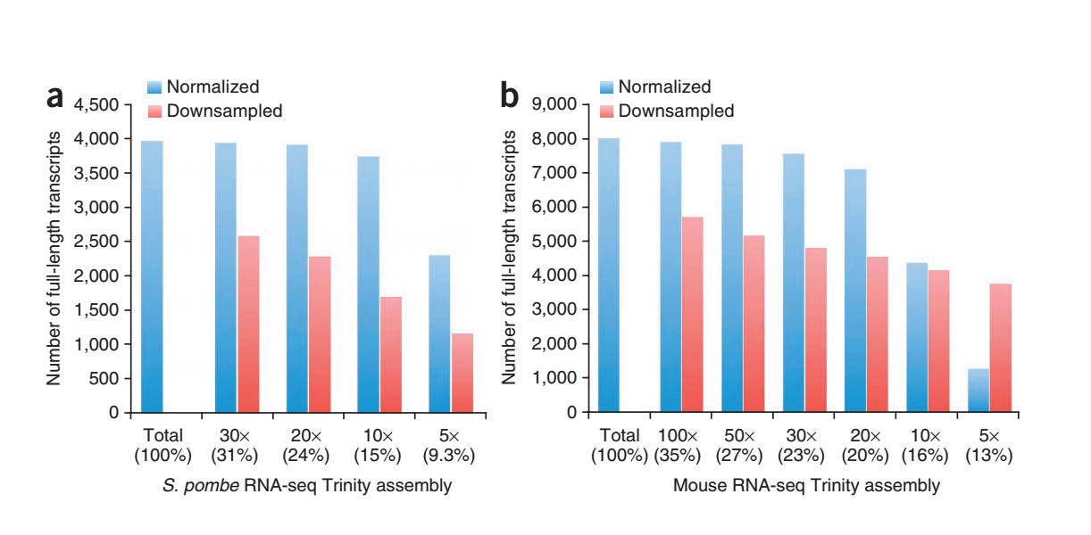
Impact of Normalization on De novo Full-length Transcript Reconstruction
Largely retain full-length reconstruction, but use less RAM and assemble much faster.
Haas et al., 2013

Slide 38
RNA-Seq Challenge: Transcript Reconstruction
(Avg. ~ 2 kb)
(Avg. ~ 300 b)
Reconstruct original full-length transcripts
(~ 75 to 150 b reads, SE or PE)
Adapted from: http://www2.fml.tuebingen.mpg.de/raetsch/members/research/transcriptomics.html
Notes:
In any case, the transcriptome reads that are generated from sequencing are often much shorter than the original transcript molecules they were derived from, and one of the key bioinformatic challenges is to reconstruct the original full length transcript from the shorter sequencing reads.

Slide 39
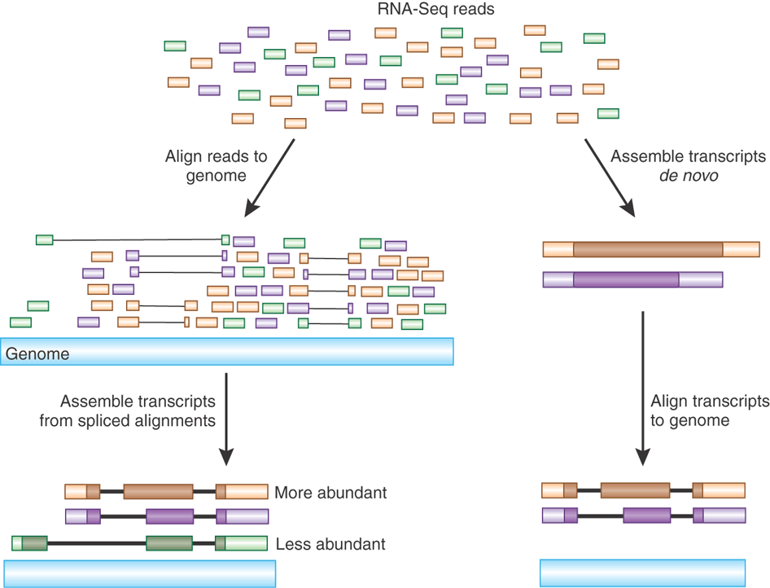
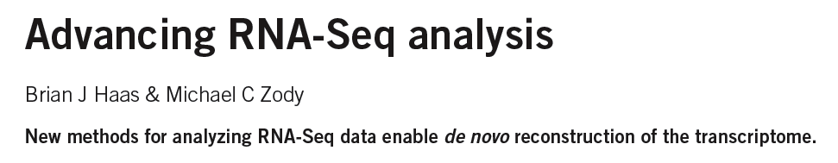
Transcript Reconstruction from RNA-Seq Reads
Nature Biotech, 2010
Notes:
There are two different commonly used strategies for reconstructing transcripts from RNA-Seq reads.

Slide 40
Transcript Reconstruction from RNA-Seq Reads
Notes:
One strategy requires having a reference genome and involves first aligning reads to the genome using a spliced aligner.
When mapping the RNA-Seq reads to the genome, the aligner takes into account that the RNA-Seq reads are derived from fully processed transcripts that have undergone intron splicing, and maps the spliced transcript fragments across intervening intronic sequences that occur in the genome.
In this view, candidate intron sequences are shown as thin lines separating the mapped read segments.

Slide 41
Transcript Reconstruction from RNA-Seq Reads
Notes:
Clusters of aligned reads reveal the exon and intron components of transcript structures, and these alignments can be further assembled into transcript isoforms.
Whenever there are multiple introns that overlap but have different splice sites, we have evidence of alternative splicing, as those splicing events had to derive from differently processed transcript molecules.

Slide 42
Transcript Reconstruction from RNA-Seq Reads
Trinity
Non-model organisms:
“I don’t have a reference genome!”
GMAP
Notes:
Although there has been much progress in the last two decades towards sequencing and assembling genomes of a wide variety of model and non-model organisms, it is still very often the case that a reference genome is not available for your organism of interest, or that the reference genome that is available is not a perfect match to your sample, which could contain significant variation.

Slide 43
Transcript Reconstruction from RNA-Seq Reads
TopHat
Cufflinks
Notes:
Instead of reconstructing transcripts using a reference genome, transcripts can be reconstructed in a genome-free way in a process termed de novo assembly.
Here, overlapping sequences between reads are directly leveraged to assemble longer transcript sequences.

Slide 44
Transcript Reconstruction from RNA-Seq Reads
TopHat
Cufflinks
Notes:
Then, if a genome sequence is available, even if it’s not a perfect match to your sample, you could align the reconstructed transcripts to that genome to further glean insights into intron and exon structures as well as any sequence variations between your transcriptome and the reference genome. This can be particularly useful in biomedical applications, as I’ll highlight later on.

Slide 45
Transcript Reconstruction from RNA-Seq Reads
Many tools to choose among:
Trinity
Oases
SoapDenovoTrans
AbyssTrans
IDBA-Tran
Shannon
BinPacker
Bridger
…
TopHat STAR HISAT
GSNAP
…
GMAP
BLAT
AAT
Spidey
Sim4
…
Cufflinks
Stringtie
IsoLasso
Bayesembler
Trip
Traph
CEM
TransComb
…
Notes:
Since the advent of RNA-Seq about a decade ago, there has been great progress in the development of bioinformatics tools for performing all of these operations, supporting both genome-guided and genome-free transcriptome reconstruction and analysis.
In the next series of slides, I’ll describe the basic computational algorithms used for transcript reconstruction.

Slide 46
Graph Data Structures Commonly Used For Assembly
Sequence
Order
Orientation (+, -)
Overlap
Reads to Graph
GTC
AGTCA
GATC
CG
GATTACA
CGATCA
AGC
Nodes = sequence (+/-)
Edges = order, overlap
Notes:
Both the genome-guided and genome-free transcript reconstruction approaches share some common algorithmic techniques.
----
A general features of these algorithms is to encode read sequences, read order, orientation, and overlap information
---
into a directed graph structure, with oriented sequences represented by nodes, and directed edges indicating overlap and orientation.

Slide 47
Graph Data Structures Commonly Used For Assembly
Sequence
Order
Orientation (+, -)
Overlap
Reads to Graph
GTC
AGTCA
GATC
CG
GATTACA
CGATCA
AGC
GATCGTCCGAGCGATTACA
Nodes = sequence (+/-)
Edges = order, overlap
Notes:
Full length transcripts are then reconstructed by traversing a directed path in the graph, guided by characteristics of the original reads including mate-pair constraints.
If there are multiple well-supported paths through this graph, then this would be considered evidence for alternative splicing.

Slide 48
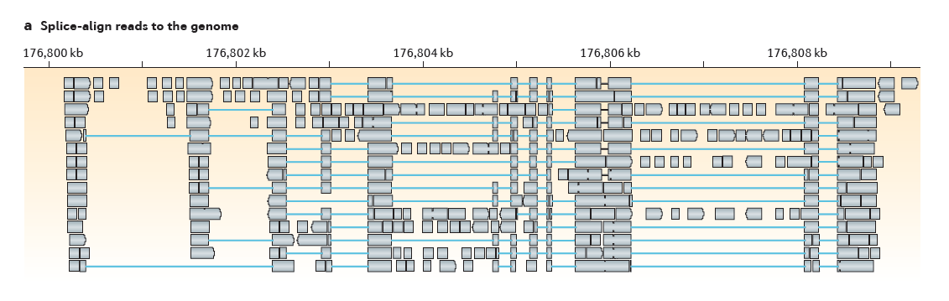
Genome-Guided Transcript Reconstruction
Splice-align reads to the genome
From Martin & Wang. Nature Reviews in Genetics. 2011
Notes:
In the case of genome-guided transcript reconstruction, the reads are aligned to the genome instead of being aligning to each other, and so we don’t encounter this scalability problem.
Here, the genome provides a scaffold by which the reads are ordered, oriented, and their overlaps are readily defined according to genomic location.
Here’s an example of a region of the genome where RNA-Seq reads were aligned…

Slide 49
Genome-Guided Transcript Reconstruction
Splice-align reads to the genome
Alignment segment piles => exon regions
From Martin & Wang. Nature Reviews in Genetics. 2011
Notes:
and we see stacks of reads piling up at locations throughout this locus.
The piles of alignment segments provide evidence of exons

Slide 50
Genome-Guided Transcript Reconstruction
Splice-align reads to the genome
Large alignment gaps => introns
From Martin & Wang. Nature Reviews in Genetics. 2011
Notes:
And the large gaps between alignment segments provide evidence of introns that were spliced out in the mature transcript.

Slide 51
Genome-Guided Transcript Reconstruction
Splice-align reads to the genome
Overlapping but different introns = evidence of alternative splicing
From Martin & Wang. Nature Reviews in Genetics. 2011
Notes:
In some cases, candidate introns are found to overlap but have different end points, and this provides evidence of alternative splicing.

Slide 52
Genome-Guided Transcript Reconstruction
Splice-align reads to the genome
From Martin & Wang. Nature Reviews in Genetics. 2011
Notes:
As discussed earlier, in order to assemble transcripts we’re going to encode the RNA-Seq data into a directed graph.
Based on the RNA-Seq read alignments, we were able to identify the individual exon and intron components of the gene expressed at this locus.

Slide 53
Genome-Guided Transcript Reconstruction
Splice-align reads to the genome
Individual reads can yield multiple exon and intron segments (splice patterns)
From Martin & Wang. Nature Reviews in Genetics. 2011
Notes:
If we look carefully, we can find examples of individual reads aligning to the genome and providing evidence for multiple introns and exons, and so we know that those introns and exons should be connected in the final transcript reconstructions.

Slide 54

Genome-Guided Transcript Reconstruction
Splice-align reads to the genome
Nodes = unique splice patterns
From Martin & Wang. Nature Reviews in Genetics. 2011
Notes:
We can identify all such unique splice patterns provided by the reads, and start building our graph using the splice patterns as nodes.

Slide 55
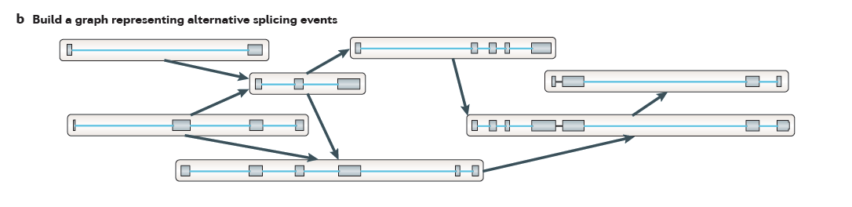
Genome-Guided Transcript Reconstruction
Splice-align reads to the genome
Construct graph from unique splice patterns of aligned reads.
Nodes = unique splice patterns
From Martin & Wang. Nature Reviews in Genetics. 2011
Notes:
We do this for all unique splice patterns. Here, the number of splice patterns is just a small fraction of the total number of aligned reads, and so we have a relatively few number of nodes to work with in our graph.

Slide 56
Genome-Guided Transcript Reconstruction
Splice-align reads to the genome
Construct graph from unique splice patterns of aligned reads.
Nodes = unique splice patterns
Edges = compatible patterns
From Martin & Wang. Nature Reviews in Genetics. 2011
Notes:
We then incorporate edges into the graph, drawing an edge between splice patterns that overlap and are compatible, that is to say that they could have come from the same transcript isoform. These are all cases where the splice patterns overlap and if there are introns in the overlapping region, those introns have identical splice sites.
For example, these top two alignment patterns overlap and they don’t conflict in their region of overlap. They could have come from the same transcript isoform, and so we can draw an edge between them.
----
Similarly, this splicing pattern demonstrates overlap, and the overlapping introns have identical splice sites, so these are deemed compatible, possibly deriving from the same transcript isoform, and we draw an edge between them.
----
We do this for all overlapping splice patterns.

Slide 57
Genome-Guided Transcript Reconstruction
Splice-align reads to the genome
Construct graph from unique splice patterns of aligned reads.
Nodes = unique splice patterns
Edges = compatible patterns
From Martin & Wang. Nature Reviews in Genetics. 2011
Notes:
Here we have those splice patterns that overlap but have different introns, and these could not have come from the same transcript, so we cannot draw an edge between them in our graph.

Slide 58
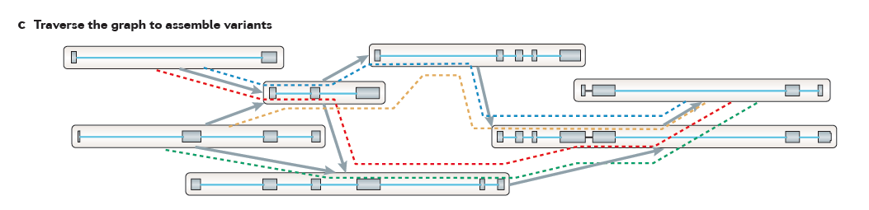
Genome-Guided Transcript Reconstruction
Traverse paths through the graph to assemble transcript isoforms
From Martin & Wang. Nature Reviews in Genetics. 2011
Notes:
Once we’ve completed our graph, we can then traverse paths through the graph to reconstruct candidate isoforms.
Here, we’ve outlined 4 possible paths…

Slide 59
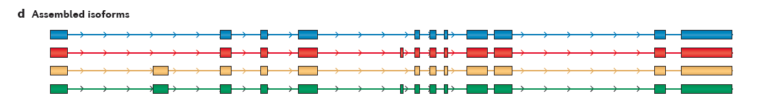
Genome-Guided Transcript Reconstruction
Traverse paths through the graph to assemble transcript isoforms
Reconstructed isoforms
From Martin & Wang. Nature Reviews in Genetics. 2011
Notes:
And tracing each path yields a different transcript structure.
There are a large number of variations of this technique, and it usually involves scoring the possible paths according to some objective function, and only reporting those candidate isoform reconstructions that are best supported by the read alignments.

Slide 60
What if you don’t have a high quality reference genome sequence?

Slide 61
Read Overlap Graph: Reads as nodes, overlaps as edges
Notes:
One way to build such a graph is treat each read as a separate node, and to perform all combinations of pairwise alignments between reads in order to identify overlaps and extensions.

Slide 62
Read Overlap Graph: Reads as nodes, overlaps as edges
Node = read
Edge = overlap
Notes:
From the overlap information, we would build an overlap graph with reads as nodes and overlaps as edges.

Slide 63
Read Overlap Graph: Reads as nodes, overlaps as edges
Transcript A
Generate consensus sequence where reads overlap
Node = read
Edge = overlap
Transcript B
Notes:
One could then trace the path of overlap extensions to assemble the longer sequence
----
If there are minor sequence differences in the regions of overlap that are likely due to sequencing error, these could be corrected by just taking a consensus and taking any original read quality information into account.

Slide 64
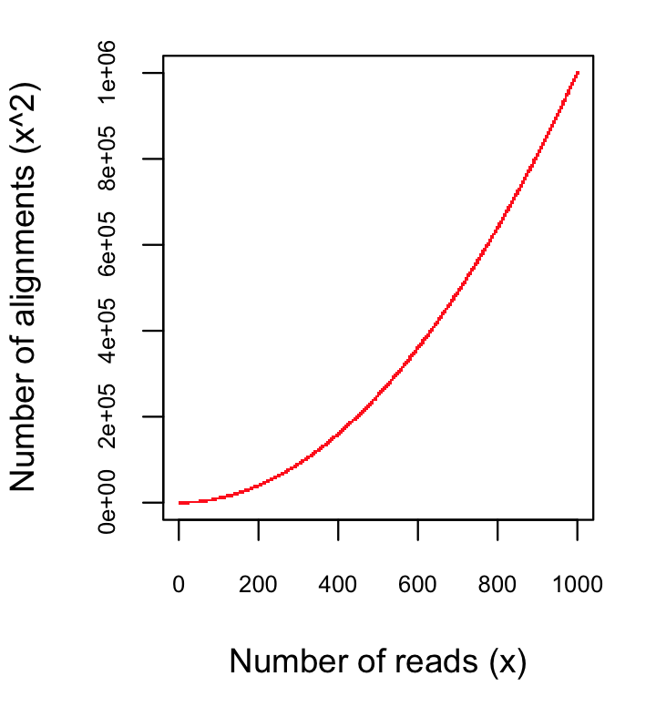
Finding pairwise overlaps between n reads involves ~ n² comparisons.
Impractical for typical RNA-Seq data (50M reads)
Notes:
This approach can be highly effective, but it simply doesn’t scale well for large data sets such as those generated using RNA-Seq.
Building the overlap graph involved aligning and comparing each read to every other read. If we have ‘n’ reads, then this would involve roughly n^2 number of comparisons.
----
If we plot the number of pairwise alignments required as a function of the number of reads, we see that the number of alignments grows exponentially.
----
This is a problem because it means that the amount of time it would take to do the alignments as well as the amount of computer hardware required to store the information would also grow exponentially, and so it’s just not a viable approach for assembling the many millions or billions of reads generated in an RNA-Seq experiment.

Slide 65
No genome to align to… De novo assembly required
Want to avoid n² read alignments to define overlaps
Use a de Bruijn graph
Notes:
If we don’t have a genome to align to, we need to be able to assemble the reads directly, but we need a way to avoid doing all pairwise alignments between the reads.
----
A popular technique for doing de novo assembly of short reads is to leverage a de Bruijn graph data structure. The de Bruijn graph was initially applied to genome assembly and was later adopted for transcriptome assembly. There are some key differences between assembling genomes and assembling transcriptomes using de Bruijn graphs, and I’ll comment more on that shortly.

Slide 66
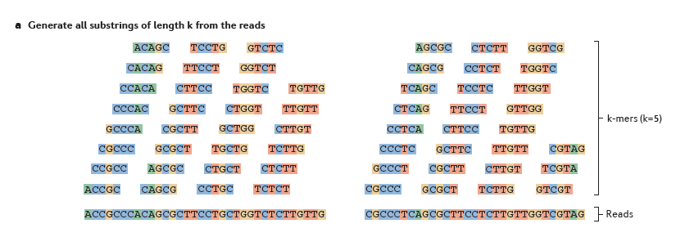
Sequence Assembly via de Bruijn Graphs
Generate all substrings of length k from the reads
k-mers (k=5)
Reads
From Martin & Wang, Nat. Rev. Genet. 2011
Notes:
A de Bruijn graph represents connectivity between sequences observed within reads, and the overlaps between reads are apparent by the virtue of having shared substrings.
The first step in a de Bruijn graph-based assembly is to construct the de Bruijn graph from the sequence reads.
Each read is decomposed into substrings of some specified length k. Each word of length k is called a k-mer. In this example, k is set to 5, so here each 5-mer is extracted from the read.
----
An ordered list of k-mers is generated by scanning a window of length k across the length of the read.

Slide 67
Sequence Assembly via De Bruijn Graphs
Generate all substrings of length k from the reads
k-mers (k=5)
Reads
From Martin & Wang, Nat. Rev. Genet. 2011
Notes:
That kmer is extracted from the read sequence

Slide 68
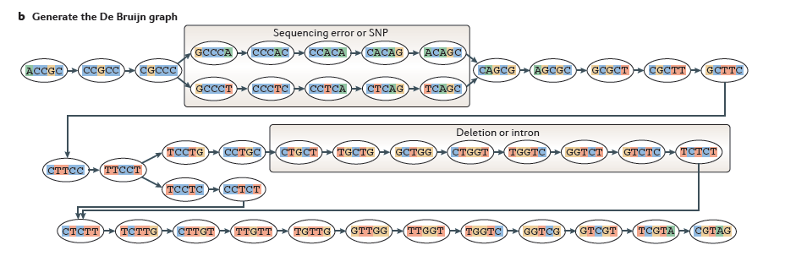
Sequence Assembly via De Bruijn Graphs
Generate all substrings of length k from the reads
k-mers (k=5)
Reads
Construct the de Bruijn graph
Nodes = unique k-mers
From Martin & Wang, Nat. Rev. Genet. 2011
Notes:
and inserted as a node in our de Bruijn graph. This graph node now represents this unique kmer sequence, and this single node will represent this unique kmer for every occurrence of this kmer in the entire set of reads.

Slide 69
Sequence Assembly via De Bruijn Graphs
Generate all substrings of length k from the reads
k-mers (k=5)
Reads
Construct the de Bruijn graph
Nodes = unique k-mers
Edges = overlap by (k-1)
From Martin & Wang, Nat. Rev. Genet. 2011
Notes:
We then shift the window over by one base, extract that k-mer…

Slide 70
Sequence Assembly via De Bruijn Graphs
Generate all substrings of length k from the reads
k-mers (k=5)
(k-1) overlap
Reads
Construct the de Bruijn graph
Nodes = unique k-mers
Edges = overlap by (k-1)
From Martin & Wang, Nat. Rev. Genet. 2011
Notes:
and insert it as another node in our de Bruijn graph.

Slide 71
Sequence Assembly via De Bruijn Graphs
Generate all substrings of length k from the reads
k-mers (k=5)
(k-1) overlap
Reads
Construct the de Bruijn graph
Nodes = unique k-mers
Edges = overlap by (k-1)
From Martin & Wang, Nat. Rev. Genet. 2011
Notes:
For each pair of neighboring k-mers, which overlap by k-1 bases, we include an edge between them in the graph.

Slide 72
Sequence Assembly via De Bruijn Graphs
Generate all substrings of length k from the reads
k-mers (k=5)
Reads
Construct the de Bruijn graph
Nodes = unique k-mers
Edges = overlap by (k-1)
From Martin & Wang, Nat. Rev. Genet. 2011
Notes:
We continue to do this for all reads and fully construct our de Bruijn graph.
This de Bruijn graph is a very effective and compact way of representing the sequence data within the reads. For example, hundreds of millions of reads can be sequenced, and the identical sequence regions within reads become compressed into individual nodes within the graph.
At positions where related sequences diverge due to allelic polymorphisms, splicing variations, repeats, or due to sequencing errors, the graph will branch and can form bulges or loops.

Slide 73
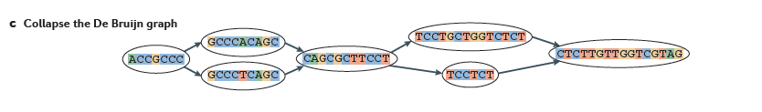
Construct the de Bruijn graph
Collapse the de Bruijn graph
From Martin & Wang, Nat. Rev. Genet. 2011
Notes:
After building the graph from all the reads, the graph is typically pruned to remove bubbles and structures that likely stem from sequencing errors,
and the graph is further simplified by collapsing those nodes that form linear unbranched chains of overlapping k-mers.
--
For example, this linear chain of kmers is compressed into a single node in the compacted graph.

Slide 74
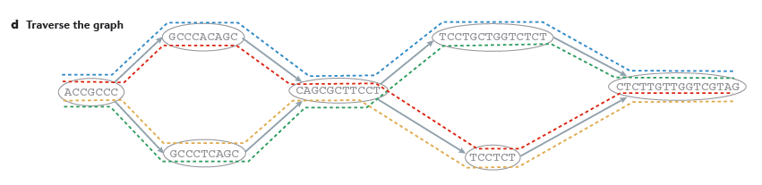
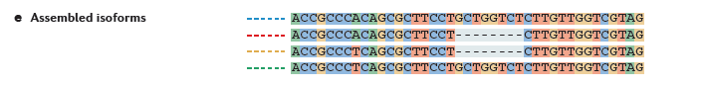
Collapse the de Bruijn graph
Traverse the graph
Assemble Transcript Isoforms
From Martin & Wang, Nat. Rev. Genet. 2011
Notes:
Now, to reconstruct transcripts, we define paths in the graph that are supported by the reads, and traverse those paths to reconstruct complete isoform sequences.
--
In this example, there are again four possible paths from the beginning to the end of the graph, each path shown traced by a different color.
By traversing each path, a different transcript sequence is generated.
--
Again, there are many different algorithms and techniques for defining best paths within this graph, and ideally the best paths reported are those that are best supported by the RNA-Seq data, taking into account the paths supported by individual read sequences and any mate-pairing information that may be available.

Slide 75

Contrasting Genome and Transcriptome De novo Assembly
Genome Assembly
Transcriptome Assembly
Uniform coverage
Exponentially distributed coverage levels
Single contig per locus
Multiple contigs per locus (alt splicing)
Assemble small numbers of large Mb-length chromosomes
Assemble many thousands of Kb-length transcripts
Double-stranded data
Strand-specific data available
Notes:
Both genome and transcriptome assemblers make use of de Bruijn graphs for assembly, but they are tuned to assemble reads according to very different expected characteristics. This is why you wouldn’t want to leverage a genome assembler for transcriptome assembly and vice-versa, since each method is highly specialized.
Some of the key differences between what’s expected by genome and transcriptome assemblers include the following:
--
Genome assemblers expect that read coverage is going to be rather uniform and will often discard sequences that occur at high coverage as repetitive sequences. In contrast, transcriptome assembly needs to consider a wide range of coverage levels spanning several orders of magnitude since sequences with high coverage are more likely to represent highly expressed transcripts instead of repeats.
--
Genome assemblers typically aim to generate a single contig per locus. In transcriptome assembly, it’s understood that single genes can generate many alternatively spliced transcripts, and multiple contigs are reported per locus where evidence of transcript complexity exists.
--
Genome assemblers aim to produce small numbers of very long contig, ideally reconstructing entire megabase-sized chromosomes where possible. Transcriptome assemblers are generally tasked with assembling many thousands of separate transcripts, on the order of thousands of bases in length.
--
Finally, in genome assembly, reads are assumed to be derived from either strand of the double-stranded DNA molecule. Conventional RNA-Seq offers the option of generating strand-specific data, and Transcriptome assemblers need to consider strand-specific data in order to assemble sense and antisense transcripts separately.

Slide 76
Trinity Aggregates Isolated Transcript Graphs
Genome Assembly
Single Massive Graph
Trinity Transcriptome Assembly
Many Thousands of Small Graphs
Entire chromosomes represented.
Ideally, one graph per expressed gene.
Notes:
A significant difference between Trinity as compared to all other assemblers is how it goes about building the graphs.
Genome assemblers (and other transcriptome assemblers that are built on top of genome assemblers) typically build single large graphs.
Trinity instead tries to partition the data into many thousands of small graphs, ideally one graph per expressed gene. This is possible because most expressed transcripts tend to be non-overlapping.
Having many small graphs lends itself to massive parallel processing, which is an added computational benefit.

Slide 77
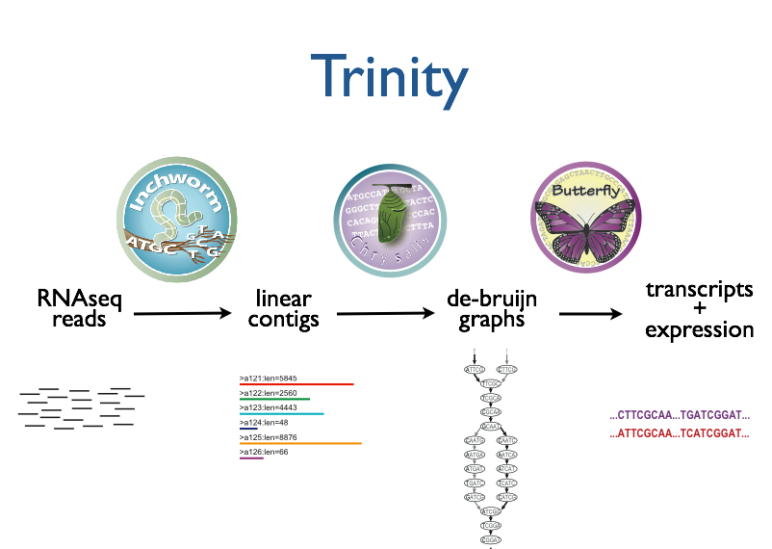



Trinity – How it works:
RNA-Seq reads
Linear
contigs
de-Bruijn
graphs
Transcripts
+
Isoforms
Thousands of disjoint graphs
Notes:
Here’s a high-level overview of the whole Trinity assembly algorithm.
We call it Trinity because it involves three major steps that we’ve built into three separate software modules.
It starts with Inchworm, which first assembles the RNA-Seq data into linear contigs.
Then, Chrysalis groups contigs that are related due to alternative splicing or gene duplication and constructs de bruijn graphs.
Finally, Butterfly examines reads in the context of the de bruijn graphs, and reports the final full-length transcripts and isoforms of transcripts.

Slide 78
Inchworm Algorithm
Decompose all reads into overlapping Kmers => hashtable(kmer, count)
Read:
AATGTGAAAACTGGATTACATGCTGGTATGTC…
AATGTGA
ATGTGAA
Overlapping kmers of length (k)
TGTGAAA
…
Kmer Catalog (hashtable)
Kmer | Count among all reads
AATGTGA | 4
ATGTGAA | 2
TGTGAAA | 1
GATTACA | 9
Notes:
The inchworm algorithm is quite simple.
It first decomposes reads into a catalog of overlapping Kmers,
----
and builds a hashtable containing the kmers and the count of the number of times that kmer is found in all the reads.

Slide 79
Inchworm Algorithm
Decompose all reads into overlapping Kmers => hashtable(kmer, count)
Identify seed kmer as most abundant Kmer, ignoring low-complexity kmers.
GATTACA
9
Kmer Catalog (hashtable)
Kmer | Count among all reads
AATGTGA | 4
ATGTGAA | 2
TGTGAAA | 1
GATTACA | 9
Notes:
The single most abundant kmer with reasonable sequence complexity is identified as a seed kmer.

Slide 80
Inchworm Algorithm
Decompose all reads into overlapping Kmers => hashtable(kmer, count)
Identify seed kmer as most abundant Kmer, ignoring low-complexity kmers.
Extend kmer at 3’ end, guided by coverage.
G
A
GATTACA
9
T
C
Notes:
This seed kmer is then extended at the 3’ end guided by the coverage of overlapping kmers.
For each extension, there are four possible kmers, each ending with one of the four possible nucleotides.

Slide 81
Inchworm Algorithm
G
4
A
GATTACA
9
T
C
Notes:
Each of the possible overlapping kmers is looked up in the kmer catalog to determine their frequency within the reads.
In this toy example, the kmer ending with ‘G’ is found 4 times.

Slide 82
Inchworm Algorithm
G
4
A
GATTACA
1
9
T
C
Notes:
‘A’ is found once.

Slide 83
Inchworm Algorithm
G
4
A
GATTACA
1
9
T
0
C
Notes:
The kmer ending with ‘T’ doesn’t exist in the reads, so it has a count of zero.

Slide 84
Inchworm Algorithm
G
4
A
GATTACA
1
9
T
0
C
4
Notes:
And the kmer ending with ‘C’ is found 4 times.

Slide 85
Inchworm Algorithm
G
4
A
GATTACA
1
9
T
0
C
4
Notes:
In this case we have a tie.

Slide 86
Inchworm Algorithm
G
A
0
5
T
1
G
4
C
A
0
GATTACA
1
9
T
0
G
C
1
4
A
1
C
T
1
1
Notes:
When we encounter a tie, we explore the tied paths recursively to find that extension that provides the highest cumulative coverage.

Slide 87
Inchworm Algorithm
G
A
0
5
T
1
G
4
C
A
0
GATTACA
1
9
T
0
G
C
1
4
A
1
C
T
1
1
Notes:
In this case, the extension of two overlapping kmers ending with an ‘A’ provides the highest cumulative coverage, and so the other paths are ignored.

Slide 88
Inchworm Algorithm
A
5
G
4
GATTACA
9
Notes:
Extensions continue to occur in this way until there are no more kmers that provide for an extension.

Slide 89
Inchworm Algorithm
A
5
C
G
0
4
T
0
GATTACA
A
9
6
G
1
Notes:
Then, we extend from right to left in the same manner, following the path of greatest coverage.

Slide 90
Inchworm Algorithm
A
5
G
4
GATTACA
A
9
6
A
7
Report contig: ….AAGATTACAGA….
Remove assembled kmers from catalog, then repeat the entire process.
Notes:
Once the extension completes, the assembled contig is reported.
--transition—
The kmers found in the contig are removed from the kmer catalog, and the entire process is repeated starting from a new seed. The Inchworm assembly ends when the entire k-mer catalog has been depleted.

Slide 91
Inchworm Contigs from Alt-Spliced Transcripts
Expressed isoforms
Isoform A
Isoform B
Notes:
Inchworm alone performs well at reconstructing full-length transcripts, but in the case of alternative splicing, inchworm alone is unable to reconstruct full-length transcripts for each of the isoforms.
This is because it assembles contigs from unique kmers and the sequences shared between isoforms can be reported in only one Inchworm contig.
For example, here are two expressed isoforms which share the orange and green sequence regions in common, and Isoform A has a stretch of unique sequence shown in yellow, such as coming from an exon skipped in isoform B.

Slide 92

Inchworm Contigs from Alt-Spliced Transcripts
Expressed isoforms
Expression
Isoform A
(low)
Isoform B
(high)
Graphical representation
Notes:
This can be represented graphically like so. Based on the read support, we find that Isoform B is highly expressed as compared to Isoform A, and we indicate that in the graph by the thicker edge.

Slide 93
Inchworm Contigs from Alt-Spliced Transcripts
Notes:
When Inchworm greedily assembles k-mers, it will often report the more highly expressed isoform as a single full-length contig.

Slide 94
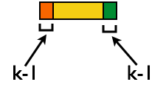
Inchworm Contigs from Alt-Spliced Transcripts
+
No k-mers in common
Notes:
And only the unique regions of alternatively spliced isoforms are reported as separate contigs.
Again, these contigs share no k-mers in common.
The remaining components of Trinity are responsible for linking these related contigs together and reporting more complete sequences for each. This is where Chrysalis first comes in.

Slide 95
Inchworm Contigs from Alt-Spliced Transcripts
+
Notes:
Although these inchworm contigs lack complete kmers in common, they maintain partial kmer overlap at points where the isoforms diverge.
The smaller contig can still be associated with the larger contig based on these partial kmers of length k-1, and we can find reads to support the junction.

Slide 96
Chrysalis Re-groups Related Inchworm Contigs
+
Chrysalis uses (k-1) overlaps and read support to link related Inchworm contigs
Notes:
The Chrysalis tool, in the next step, exploits these partial kmers to regroup related contigs. If reads exist that support the junction at the k-1 overlaps, then Chrysalis will cluster the inchworm contigs together.

Slide 97
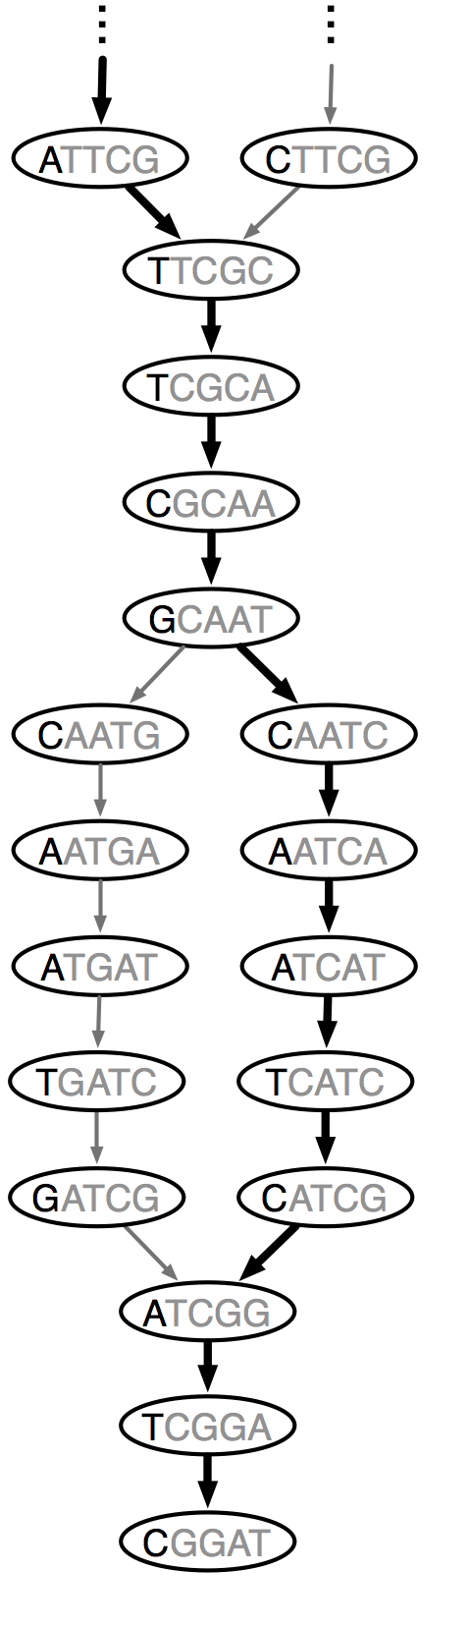
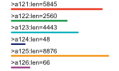
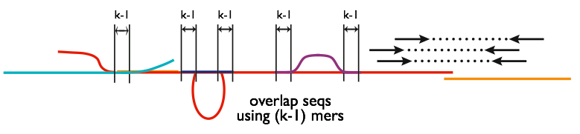
Chrysalis
Integrate isoforms
via k-1 overlaps
Build de Bruijn Graphs
(ideally, one per gene)
Notes:
Here is a high-level overview of the Chrysalis operations.
Chrysalis clusters related contigs based on these k-1mer overlaps.
Chyrsalis also leverages read pairing information to join minimally overlapping contigs.
--
After identifying the connected inchworm contigs, it constructs a separate de Bruijn graph for each group.
(Again, the de Bruijn graph represents the overlaps between adjacent kmers in the sequences with branches at sites of variation.)

Slide 98
Thousands of Chrysalis Clusters
Notes:
And this is how we end up with many separate graphs, ideally one graph per gene, with each graph representing the transcriptional complexity at that locus.
These graphs can then be processed in a parallel fashion by the next step of Trinity involving Butterfly.

Slide 99
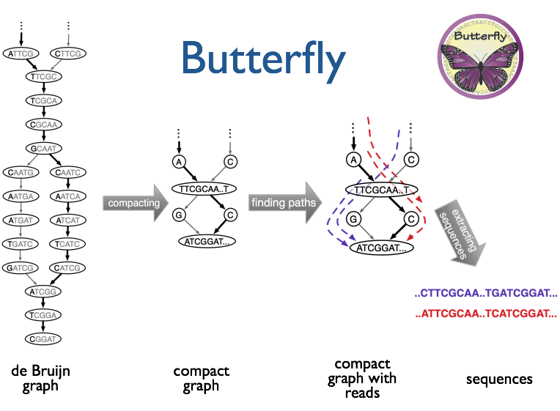
(isoforms and paralogs)
Notes:
Butterfly operates on each of these graphs independently.
It first compacts the de Bruijn graph by collapsing the unbranched stretches, as described earlier.
It then threads the original sequencing reads into the graph, tracking the paths occupied by the reads and those paths supported by mate pairs.
Butterfly then reports the most probable paths through the graph supported by the reads and read pairings, emitting full-length transcripts for isoforms and paralogs.

Slide 100
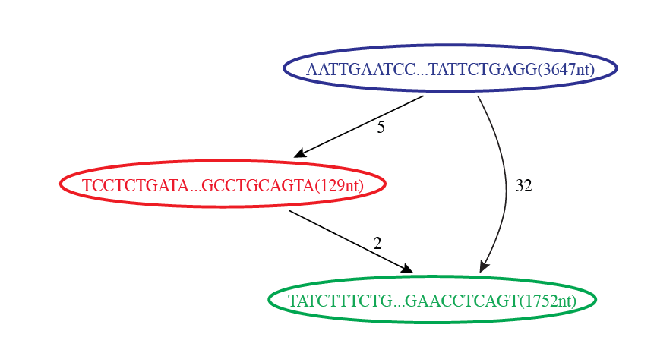

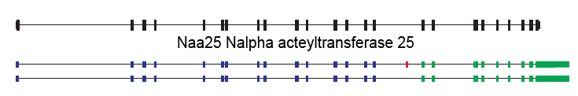
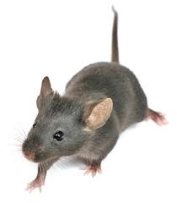
Butterfly Example 1: Reconstruction of Alternatively Spliced Transcripts
Butterfly’s Compacted Sequence Graph
Reconstructed Transcripts
Aligned to Mouse Genome
Notes:
Here’s a real example to demonstrate how this works in practice.
In our mouse RNA-Seq data set, we find a compacted de Bruijn graph that has three nodes.

Slide 101
Reconstruction of Alternatively Spliced Transcripts
Butterfly’s Compacted Sequence Graph
Reconstructed Transcripts
Aligned to Mouse Genome
Notes:
By traversing the path from the top blue node to the bottom green node, we generate a single transcript sequence.

Slide 102
Reconstruction of Alternatively Spliced Transcripts
Butterfly’s Compacted Sequence Graph
Reconstructed Transcripts
Aligned to Mouse Genome
Notes:
By traversing the alternative path through the red node, we generate another transcript sequence. This second transcript shares the blue and green segments, but contains an additional internal red segment.

Slide 103
Reconstruction of Alternatively Spliced Transcripts
Butterfly’s Compacted Sequence Graph
Reconstructed Transcripts
Aligned to Mouse Genome
(Reference structure)
Notes:
From mapping the transcripts to the reference genome sequence we can see that the inserted sequence actually corresponds to a cassette exon that is alternatively spliced, and novel given that it wasn’t found in the reference transcript structure.

Slide 104
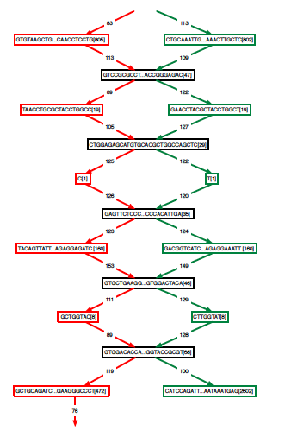
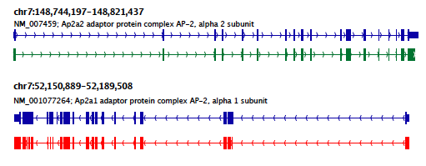
Teasing Apart Transcripts of Paralogous Genes
Butterfly Example 2:
Ap2a1
Ap2a2
Notes:
Some transcript graphs are far more complex.
Here we have an example of two such transcripts derived from paralogous genes that became intertwined in the compacted graph due to stretches of sequence identity among segments of the transcripts.
Shared sequences are represented by the central sequence nodes and paralog-specific sequences are represented by branched nodes.
By tracing consistent paths of reads through the graph, Butterfly is able to tease apart the paralogous gene sequences and report the individual transcripts. In this case, the green path yields one of the transcripts and the red path yields the other.

Slide 105
Teasing Apart Transcripts of Paralogous Genes
Ap2a1
Ap2a2
Notes:
These transcripts, when mapped to the mouse genome match perfectly with the reference gene structures. Here, the reference structures are shown in blue, and the Trinity-reconstructed transcripts are shown below.

Slide 106
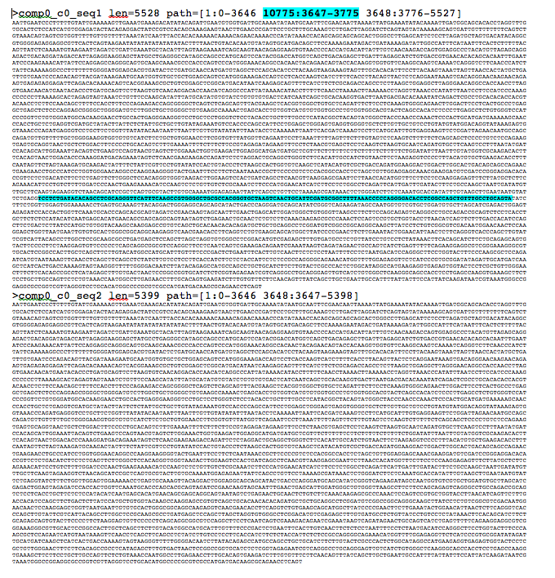
Trinity output: A multi-fasta file

Slide 107



Notes:
Last year, we published a paper in Nature Protocols that outlines how you would perform a Trinity de novo assembly followed by supported downstream analyses including abundance estimation, differential expression analysis, and exploring patterns of transcript expression across multiple sample types.

Slide 108


Slide 109




Framework for De novo Transcriptome Assembly and Analysis
1.3 Billion
Total Reads
86 Million
Normalized Reads
Bowtie & RSEM
EdgeR,
Bioconductor,
& Trinity
Notes:
Here’s a zoomed-in view of the generic protocol, which we applied here in this study.
In our case, we’re applying it to axolotl and the various axolotl tissues.
We combined all the reads into one large set of 1.3 billion reads.
This large volume of reads is in far excess of what’s needed for a de novo assembly and contains massive redundancy of reads that correspond to the most highly expressed transcripts. So, in this case, we ran the reads through an insilico normalization process that’s included in the Trinity suite to remove the excess reads, while retaining those reads that correspond to the lowly expressed transcripts. This resulted in 86 Million reads, which were then assembled using Trinity.
The original reads from the various samples and replicates were then separately aligned to the Trinity assembly in order to estimate expression levels, and this was done using Bowtie/RSEM.
Finally, EdgeR, Bioconductor, and various helper utilities in the Trinity distribution were used to analyze these data to identify differentially expressed transcripts.

Slide 110




Example Applications of the Trinity RNA-Seq Protocol

Slide 111


Biomedical Applications for de Novo Transcriptome Assembly
Fusion transcripts in Cancer
Fusions Identified in a cohort of acute myeloid leukemias (AML) using de novo transcriptome assembly.
BCR--ABL1 fusion in ~95% of chromic myelogenous leukemias (CML)
N Engl J Med. 2013 May 30; 368(22)
Notes:
There are several areas where de novo transcriptome assembly is particularly relevant to biomedical research.
Mostly, it involves cases where the reference human genome is not entirely sufficient for exploring medically relevant transcriptome samples.
This is especially the case for cancer transcriptomes.
One of the ways in which cancer can occur is through aberrant chromosome rearrangements that lead to novel gene fusions, which act as oncogenes and drive tumorigenesis. One of the best examples of this is the BCR—ABL1 fusion that is found to occur in approxmiately 95% of chronic myleogenous leukemias. This fusion gene results from a chromosomal translocation between normal chrosomes 9 and 22, generating hybrid chromosomes and yielding the BCR—ABL1 fusion gene.
This fusion gene can be easily detected by RNA-Seq de novo transcriptome assembly.
This fusion gene shows up to a lower extent in other leukemias as well.
---
A study performed a few years ago used de novo transcriptome assembly to identify a number of fusion transcripts in a cohort of acute myeloid leukemias. In this figure, the different fusion partners are shown along the circumference of the circle, and the width of lines drawn between them represent the number of patient samples containing that fusion.
----
BCR-ABL1 was found in a small number of AML samples.
----
For AML, the dominant fusion was found to be between the RARA and PML genes.
https://en.wikipedia.org/wiki/Human_papillomavirus_infection
https://www.ncbi.nlm.nih.gov/pmc/articles/PMC3767041/

Slide 112

Biomedical Applications for de Novo Transcriptome Assembly
Detection & Reconstruction of Viral and Microbial Transcripts in Cancer
Tumor Viruses
Human papilloma virus (HPV) in cervical cancer
Hepatitis B & C in liver cancer
Eppstein Barr Virus in lymphomas
T-lymphotrophic virus in adult T-cell leukemia
Bacterial / Cancer Associations
Helicobacter pylori / stomach cancer
Fusobacterium nucleatum / colon cancer
HPV
Notes:
Another biomedical application of de novo transcriptome assembly tied to cancer involves reconstructing transcripts derived from pathogens represented by reads in an RNA-Seq sample. There are several viruses and a couple of bacterial species that are known to cause cancer, and there are a number of additional microbial species that have been implicated as contributing to if not being drivers of tumorigenesis.
Transcripts corresponding to these foreign sources won’t be captured or reconstructed by aligning to a human reference genome, but they can be captured and assembled using de novo transcriptome assembly methods.
https://en.wikipedia.org/wiki/Human_papillomavirus_infection

Slide 113
Genome-guided reconstruction is more sensitive than genome-free methods
Contrasting Genome-guided and De novo Assembly
(k-1)
reads
Overlap requirements
reads
>>
Genome-free de novo assembly
Genome-guided assembly
Cufflinks (genome-guided)
# Genes w/ fully reconstructed transcripts
Trinity (genome-free)
Million PE reads
Mouse data
Notes:
In comparing genome guided to genome-free de novo assembly methods, we find that genome-guided methods have an advantage. In using the genome as a scaffold, little to no overlap between reads is required for assembly. If the reads are simply within a short distance along the genome, one might conclude that they were derived from the same transcript and reconstruct that transcript using the genome sequence to fill in any small gap.
De novo transcriptome assembly using de Bruijn graphs will require that at least two reads overlap by a certain number of bases in order to be connected within the graph.
Because of these overlap requirements, genome-guided approaches can be far more sensitive for reconstructing transcripts that are lowly expressed or have few reads due to shallow sequencing.
---
Here are the results of an example study showing the number of fully reconstructed mouse transcripts as a function of sequencing depth for a genome-guided and genome-free transcript reconstruction method. At low sequencing depth, the genome-guided method has far greater sensitivity for full-length reconstruction. As the read depth is increased, the differences do dissipate due to the de novo method capturing increased numbers of overlapping reads.

Slide 114
Summary
Transcript reconstruction from RNA-Seq data may leverage genome-guided or de novo assembly
Transcriptome assembly uses directed graph data structures and path traversal
Advantages and disadvantages to assembly approaches
Genome-guided: well-matched samples and very sensitive
De novo: almost any sample will do, but requires higher depth of read coverage
Biomedical applications for de novo transcriptome assembly
Cancer research: fusion transcripts & pathogen detection
Notes:
In summary, we’ve seen that there are two main paradigms for reconstructing transcripts based on RNA-Seq data.
These assembly approaches involve building directed graphs to represent relationships among read sequences or splice patterns and traversing paths in the graphs to reconstruct transcripts.
There are advantages and disadvantages to each approach. The genome-guided approach requires an RNA-Seq sample that’s a good match to the corresponding reference, and if they’re missing from the reference, they won’t be reconstructed. However, the genome-guided approach can be very sensitive for reconstructing lowly expressed transcripts or working in the context of shallow sequence coverage.
De novo assembly is most flexible in that it should work on just about any RNA-Seq sample, assuming the reads are not terribly short and the sequence coverage is sufficient to capture kmer-sized overlaps between reads.
And finally, we’ve seen that there are several biomedical applications for de novo transcriptome assembly, mostly focusing on those transcripts that are not well represented by the reference genome. This includes fusion transcript reconstruction in cancer samples, and detecting viral or microbial pathogens that may associate with samples derived from disease states.

Slide 115



Strand-specific RNA-Seq is Preferred
Computationally: fewer confounding graph structures in de novo assembly:
ex. Forward != reverse complement
(GGAA != TTCC)
Biologically: separate sense vs. antisense transcription
‘dUTP second strand marking’ identified as the leading protocol
Notes:
Although Trinity doesn’t absolutely require it, Strand specific rna-seq is the preferred substrate for transcriptome assembly.
Computationally, there are fewer confounding graph structures since forward kmers and the reverse complement kmers are treated as distinct.
Biologically, it’s important because it allows for the separation of sense and antisense transcription.
--
Our group at the Broad performed a study of the various methods for generating strand-specific RNA-Seq,
--
and we found the ‘dUTP second strand marking’ method to be the leading protocol.
We routinely generate strand-specific RNA-Seq as our default protocol at the Broad, and there are now kits available that make the approach readily accessible.

Slide 116
dUTP 2nd Strand Method: Our Favorite
RNA
First-strand synthesis with normal dNTPs
cDNA
Second-strand synthesis with dTTP → dUTP
U
U
UU
U
UU
Adaptor ligation
U
U
UU
U
UU
U
U
UU
U
UU
USER™
(Uracil-Specific Excision Reagent)
Remove “U”s
PCR and paired-end sequencing
Modified from Parkhomchuk et al. (2009) Nucleic Acids Res. 37:e123
Slide courtesy of Joshua Levin, Broad Institute.

Slide 117


Overlapping UTRs from Opposite Strands
Schizosacharomyces pombe
(fission yeast)
Notes:
Strand-specific RNA-Seq is tremendously useful when applied to organisms that have compact genomes.
Here’s an example from Schizosaccharomyces pombe (fission yeast) where we have two known genes that are transcribed on opposite strands and point toward each other.
We have strand specific rna-seq and the coverage plots for each strand are shown above. From the coverage plots, you can see that there’s overlap in the coverage in their UTR regions, and if we didn’t have strand-specific data, then we’d reconstruct a single transcript that covers both genes. Because we have the strand-specific data, though, Trinity is able to separately reconstruct these transcripts, allowing for overlap among their UTRs.

Slide 118

Antisense-dominated Transcription
Notes:
Here’s another example in fission yeast that highlights the importance of strand-specific rna-seq.
This region of the genome encodes three genes that are all encoded on the same strand. From the rna-seq coverage plots, we can see that the two genes on the end are transcribed on their coding strand, but the central gene encoding a meiosis specific protein kinase is dominated by transcription on the opposite strand. This antisense transcription is thought to play an important role in the regulation of meiotic genes in fission yeast, and would have gone unnoticed if we hadn’t used strand-specific rna-seq.

Slide 119
Abundance Estimation (Aka. Computing Expression Values)

Slide 120

Expression Value
Slide courtesy of Cole Trapnell
Notes:
In RNA-Seq, the expression of a transcript is measured based on the number of RNA-Seq reads sampled that map to the corresponding transcript.
The number of reads sequenced for a transcript depends on a number of factors.
For one, the number of reads observed depends on the expression of the transcript. Transcripts that are expressed at higher levels should account for more reads in the sample than those expressed at lower levels if all else is equal.
Also, the sequencing depth must be taken into account. The deeper you sequence, the more reads you’ll observe mapping to transcripts at any expression level.

Slide 121
Expression Value
Slide courtesy of Cole Trapnell
Notes:
The number of reads corresponding to a transcript also depends on its length. Longer transcripts represent more real estate in the sequencing library than shorter transcripts expressed at the same level (number of transcripts per cell).

Slide 122
Normalized Expression Values
Transcript-mapped read counts are normalized for both length of the transcript and total depth of sequencing.
Reported as: Number of RNA-Seq Fragments Per Kilobase of transcript per total Million fragments mapped
FPKM
RPKM (reads per kb per M) used with Single-end RNA-Seq reads
FPKM used with Paired-end RNA-Seq reads.
Notes:
And so, when computing expression for transcripts, both the number of reads mapping to each transcript and the lengths of those transcripts must be taken into account.
The metric reported is often in units of FPKM.

Slide 123
Transcripts per Million (TPM)
Preferred metric for measuring expression
Better reflects transcript concentration in the sample.
Nicely sums to 1 million
Linear relationship between TPM and FPKM values.
TPM
Both are valid metrics, but best to be consistent.
FPKM

Slide 124

Multiply-mapped Reads Confound Abundance Estimation
Isoform A
EM
Isoform B
Blue = multiply-mapped reads
Red, Yellow = uniquely-mapped reads
Notes:
Accurately estimating transcript expression levels is actually much more complicated due to the fact that not all RNA-Seq reads are able to map uniquely to their corresponding transcript.
This is particularly the case for alternatively spliced transcripts. Such transcripts are not entirely identical, but can share a substantial amount of sequence in common, differing at sites of splicing variation, such as due to skipped exons or from differential splice site selection.
Here’s an example of the problem, where we have two isoforms A, B, with shared sequences in blue and isoform- unique sequences in yellow or red. Reads mapping to either the yellow or red sequences will map uniquely and unambiguously. However, the reads that map to the blue regions will map ambiguously. It isn’t obvious as to which transcript the reads were derived. Using sophisticated statistical inference methods, we can infer the likelihood of a blue read having been derived from one isoform or the other, by taking into account the number of uniquely mapping reads and the length of each isoform.

Slide 125
Multiply-mapped Reads Confound Abundance Estimation
Estimate expression,
Compute likelihood
Isoform A
EM
Adj Model Params,
Proportioning Reads
Isoform B
Blue = multiply-mapped reads
Use Expectation Maximization (EM) to find the most likely assignment of reads to transcripts.
Performed by:
Cufflinks, String Tie (Tuxedo)
RSEM, eXpress (genome-free)
Kallisto, Salmon (alignment-free)
Red, Yellow = uniquely-mapped reads
Notes:
There are tools available that implement these methods, which rely on the technique of expectation maximization.
Expectation maximization involves cycling between estimating parameters of a statistical model based on the data, and computing likelihood estimates of results from applying those model parameters.
In this case, you can think of the algorithm as fractionally assigning the blue reads to each isoform and estimating the likelihood of those assignments. With each iteration of the algorithm, the read assignments become more likely, and eventually the likelihood will converge to a maximum value. Finally, the counts of reads assigned to each isoform are reported.

Slide 126

Expression Quantification Results
(ex. from Kallisto)

Slide 127

Evaluating the quality of your transcriptome assembly

Slide 128

De novo Transcriptome Assembly is Prone to Certain Types of Errors
Smith-Unna et al. Genome Research, 2016

Slide 129



Smith-Unna et al. Genome Research, 2016

Slide 130
Simple Quantitative and Qualitative Assembly Metrics
Read representation by assembly
Align reads to the assembled transcripts using Bowtie.
A typical ‘good’ assembly has ~80 % reads mapping to the assembly
and ~80% are properly paired.
Given read pair:
Possible mapping contexts in the Trinity assembly are reported:
Proper pairs
Improper pairs
Left only
Right only

Slide 131

Assembled transcript contig is only as good as its read support.
% samtools tview alignments.bam target.fasta

Slide 132

IGV

Slide 133

Can Examine Transcript Read Support Using IGV

Slide 134

Can align Trinity transcripts to genome scaffolds to examine intron/exon structures
(Trinity transcripts aligned to the genome using GMAP)

Slide 135
The Contig N50 statistic
“At least half of assembled bases are in contigs that are at least N50 bases in length”
In genome assemblies – used often to judge ‘which assembly is better’
Assemblies ordered by length:
1M
750k
500k
250k
N50 contig length = 500k

Slide 136

Often, most assembled transcripts are *very* lowly expressed
(How many ‘transcripts & genes’ are there really?)
1.4 million Trinity transcript contigs
N50 ~ 500 bases
Cumulative
# of
Transcripts
20k transcripts
-1 * minimum TPM
Expression
* Salamander transcriptome

Slide 137
N50 Calculation for Transcriptome Assemblies??
300000
…
N50 length?
In transcriptome assemblies – N50 is not very useful.
Overzealous isoform annotation for long transcripts drives higher N50
Very sensitive reconstruction for short lowly expressed transcripts drives lower N50
(small)

Slide 138

Compute N50 Based on the Top-most Highly Expressed Transcripts (ExN50)
Sort contigs by expression value, descendingly.
Compute N50 given minimum % total expression data thresholds => ExN50
N50=3457,
and
24K transcripts
90% of
expression data

Slide 139

ExN50 Profiles for Different Trinity Assemblies Using Different Read Depths
Millions of Reads
Thousands of Reads
Note shift in ExN50 profiles as you assemble more and more reads.
* Candida transcriptome

Slide 140

Evaluating the quality of your transcriptome assembly
Full-length Transcript Detection via BLASTX
M
*
Known protein (SWISSPROT)
Trinity transcript
Have you sequenced deeply enough?
* Mouse transcriptome
Haas et al. Nat. Protoc. 2013

Slide 141


Slide 142
#Summarized BUSCO benchmarking for file: Trinity.fasta
#BUSCO was run in mode: trans
Summarized benchmarks in BUSCO notation:
C:88%[D:53%],F:4.5%,M:7.3%,n:3023
Representing:
1045 Complete Single-copy BUSCOs
1617 Complete Duplicated BUSCOs
139 Fragmented BUSCOs
222 Missing BUSCOs
3023 Total BUSCO groups searched

Slide 143


Detonate: Which assembly is better?
“RSEM-EVAL [sic] uses a novel probabilistic model-based method to compute the joint probability of both an assembly and the RNA-Seq data as an evaluation score.”
“the RSEM-EVAL score of an assembly is defined as the log joint probability
of the assembly A and the reads D used to construct it”
Li et al. Evaluation of de novo transcriptome assemblies from RNA-Seq data, Genome Biology 2014

Slide 144
Detonate: Which assembly is better?
“RSEM-EVAL [sic] uses a novel probabilistic model-based method to compute the joint probability of both an assembly and the RNA-Seq data as an evaluation score.”
“the RSEM-EVAL score of an assembly is defined as the log joint probability
of the assembly A and the reads D used to construct it”
Bigger Score = Better Assembly
Li et al. Evaluation of de novo transcriptome assemblies from RNA-Seq data, Genome Biology 2014

Slide 145

Detonate: Which assembly is better?
“RSEM-EVAL [sic] uses a novel probabilistic model-based method to compute the joint probability of both an assembly and the RNA-Seq data as an evaluation score.”
Yay
Trinity!!
Ref Genome –based metric
RSEM-EVAL Genome-free metric
Li et al. Evaluation of de novo transcriptome assemblies from RNA-Seq data, Genome Biology 2014

Slide 146
Hands-on Workshop Activities
FastQC, MultiQC
Trimmomatic
Normalization
Hisat2 Bowtie2 GMAP
Full-length BlastX, ExN50
Stringtie Trinity
salmon
(Tomorrow)
IGV, R
http://journals.plos.org/ploscompbiol/article?id=10.1371/journal.pcbi.1004393

